Slide 1

Online Discussion Forum
B naresh kumar (b101253)
RGUKT - BASAR
Project Guide
Mrs.G.Srujana
Assistant Professor

Slide 2
Contents
Introduction
Objective
Modules
Technologies used
Uml diagrams
System requirement specification
Conclusion
Future Scope

Slide 3
Introduction
Project is about developing website for the discussion.
Website helps users access to features like Posting question and get the smart results by the users and experts , view the conversation and update the better results provided by website.
Registered Users can ask questions and he can get the results through premium users and Experts provided by the web site.

Slide 4
Objective
Objective of the website is to create a web site which can solve the queries of the users through utilizing its users and experts and to provide newsfeed for the users.
Through utilizing various media
To promote student collaboration and knowledge building
To create a positive learning environment
For Developing writing skills

Slide 5
Technologies Used
HTML
CSS
BootStrap
Java Script
PHP
Tools Used
Xampp Server
MySQL

Slide 6
Modules
Registration Page
Login Page
Posting Questions
Reply for Question
Update User Details
Download the discussion

Slide 7
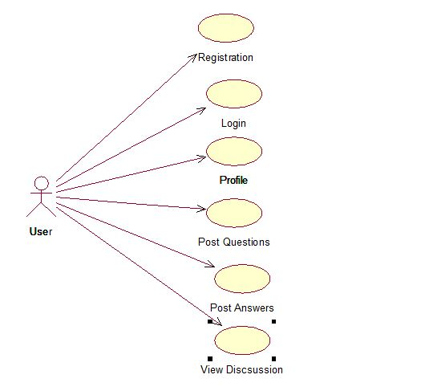
Use case diagram for user

Slide 8
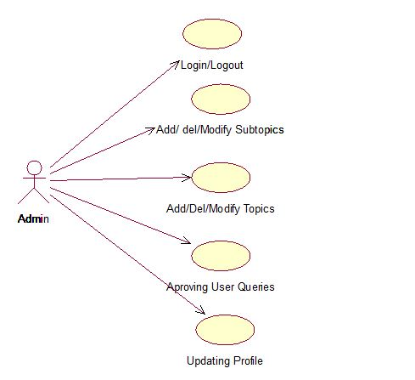
Use case for Administrator

Slide 9
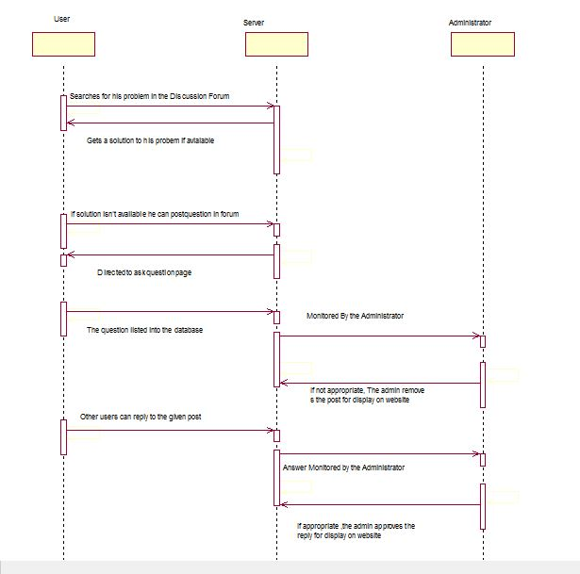
Sequence Diagram for Discussion Forum

Slide 10
System Requirement Specification
This developed web application follows the steps of Software Development Life Cycle. Under which the SRS model was developed for the system is as listed below.
The SRS Model Contains
• Functional Requirements
• Non-Functional Requirements

Slide 11
Functional Requirements
Home
Registration
Login
Profile
Post Query

Slide 12
Non Functional Requirements
Performance
Safety
Reliability

Slide 13
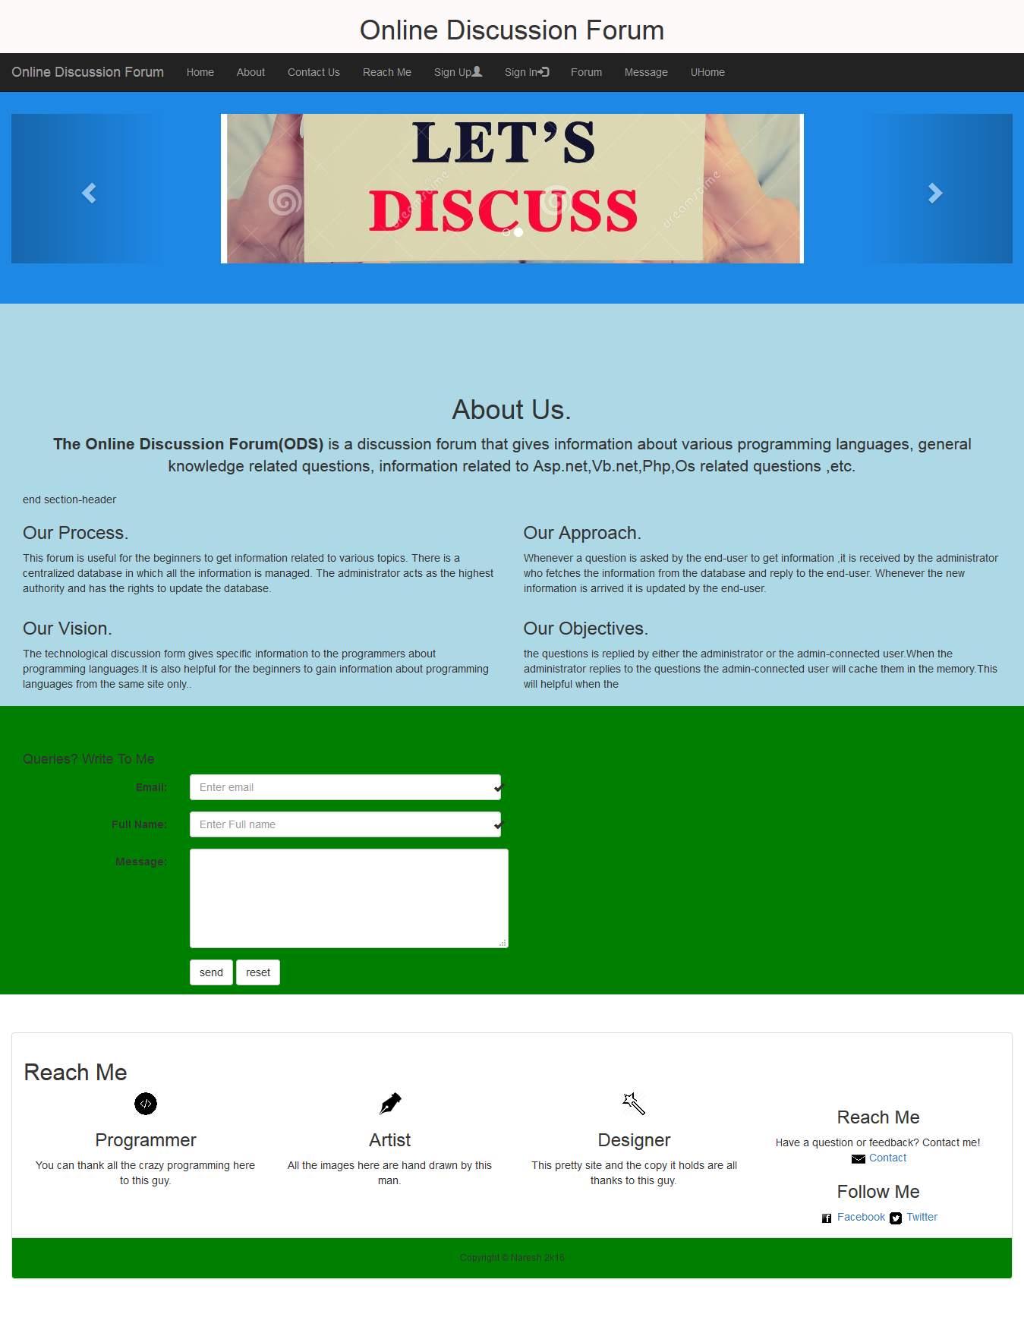
Screenshots

Slide 14
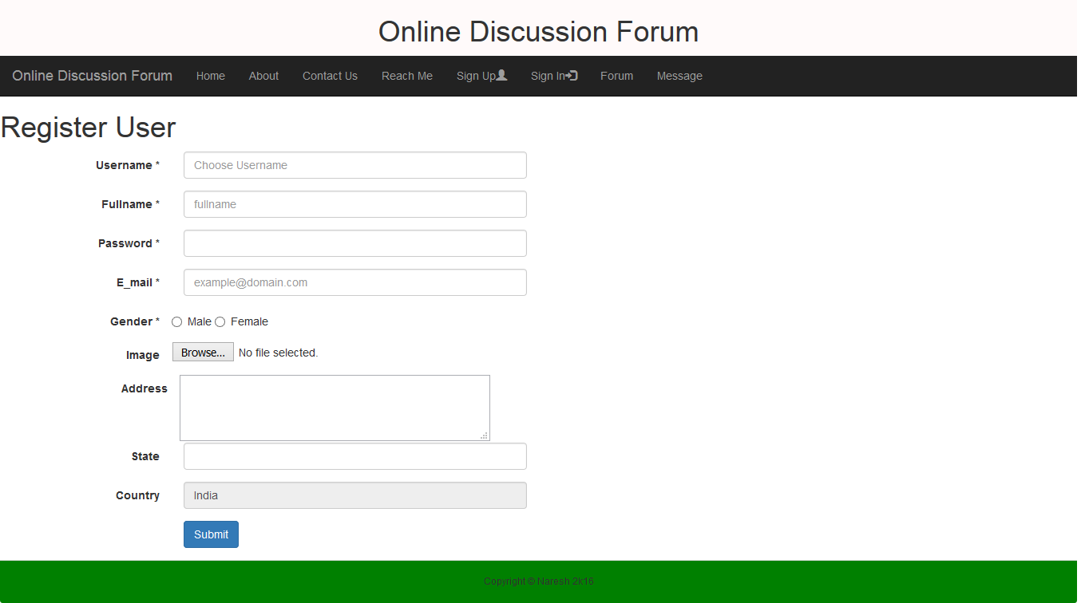
Screenshots
Registration Page

Slide 15
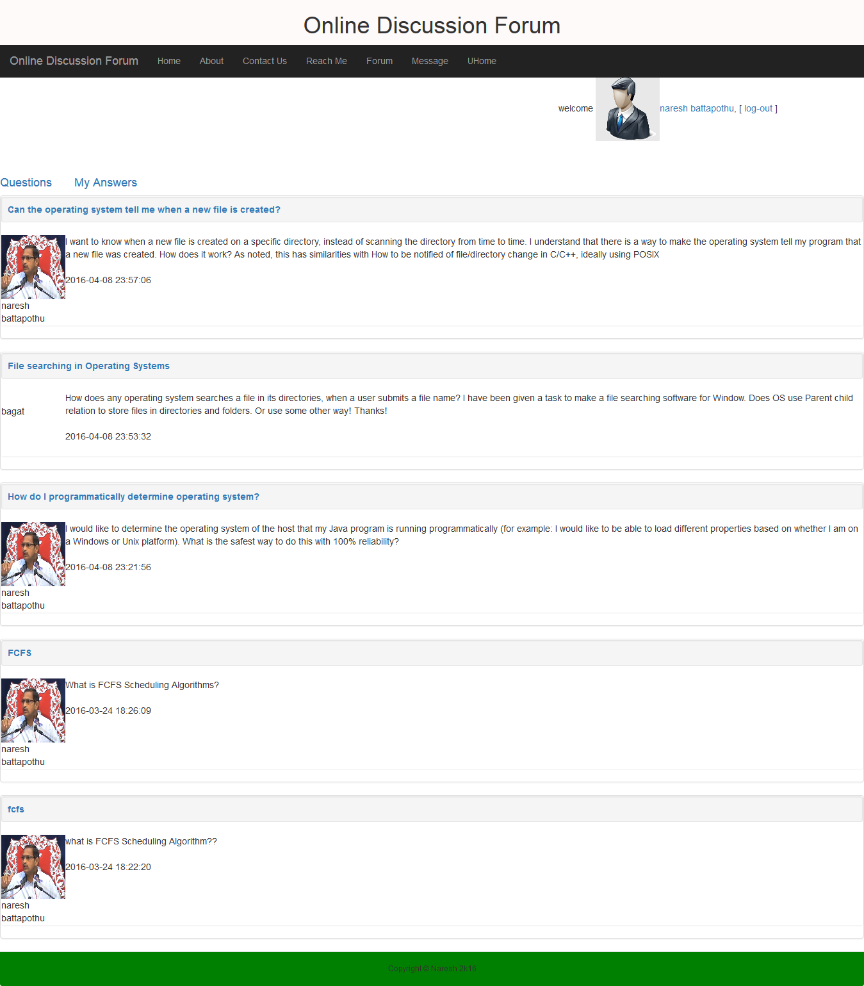
user home page

Slide 16
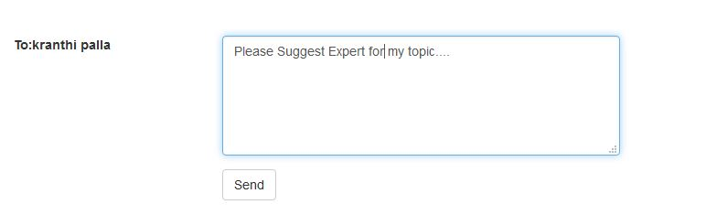
Messaging to user

Slide 17
Conclusion
User can post his question and wait for reply
User can download the question as portable document.
User can write to the Administrator.

Slide 18
Future Scope
Extending discussion to various fields by hiring experts
Notifying the user when he got reply for his question
Providing most trending news from Social and print media.

Slide 19
References
www.w3schools.com
www.tutorialspoint.com
www.getbootsrap.com
www.stackoverflow.com

Slide 20
Thank You

